Slide 1
Demo 1
Yao Yuan yyuan25@wustl.edu
Alex Lancaster alex.lancaster78@gmail.com
Yunfei Gu gu.yunfei@wustl.edu

Slide 2
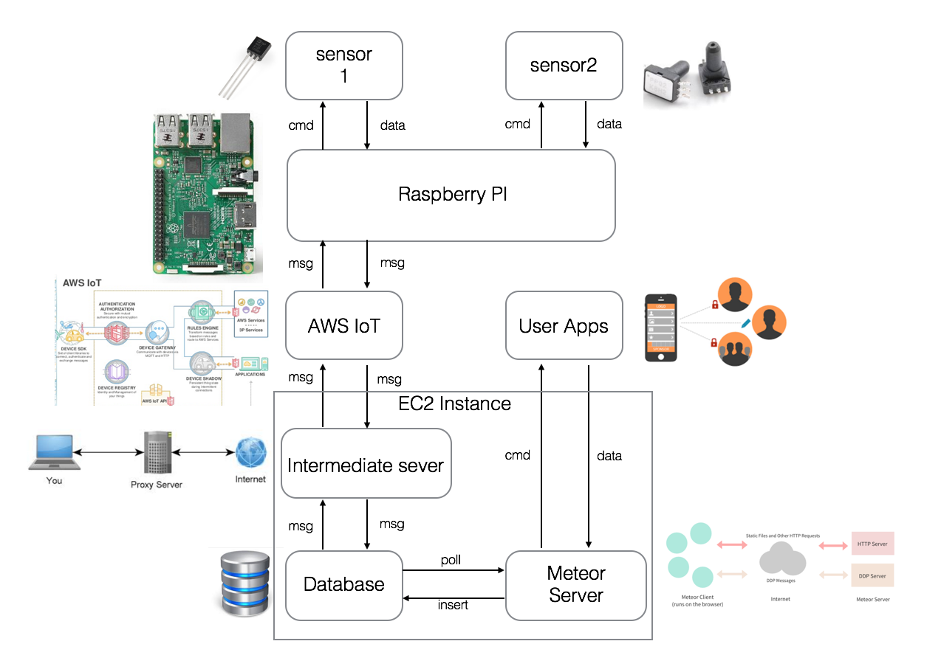
Overall Architecture

Slide 3
What We Have Done
Finished setting up connections between
Raspberry Pi and AWS_IOT
AWS_IOT and intermediate server
Intermediate server and database
Database and backend server
Backend server and front end UI
Having the sensor connected to the raspberry PI

Slide 4
Demo
Sensor publishes data to the AWS_IOT
The subscription triggered AWS SNS
SNS publishes message to the intermediate server
The server inserts the message into the database
The backend server polls the message from the database and sends the messages to the front end UI

Slide 5
What’s Next
Fix the bug in the website
Enable users to send command back to the sensor
And try out some new ideas (maybe) …

